Slide 1

Kettering
Association for
Computing Machinery
GitHub Workshop

Slide 2


WHY USE GITHUB
Collaboration & Version Control: Simplify collaboration and track changes with ease.
Seamless Teamwork: Enable multiple developers to work together efficiently.
Efficient Project Management: Manage tasks, track bugs, and prioritize work effectively.
Build a Professional Reputation: Showcase projects and contributions to employers.
Learn & Connect: Join the global developer community for learning and networking.
Security & Reliability: Prioritize code security and ensure reliable service.
Continuous Improvement: Foster learning, feedback, and code quality enhancement.

Slide 3
GIT VS GITHUB
Git is an open-source, version control tool
Stores project contents
Can return to any previous project snapshot
Great for experimenting
GitHub is a company that makes tools which integrate with git
GitHub website allows users to collaborate on a git repository

Slide 4
Ice Breakers
MAKE A REPOSITORY

Slide 5
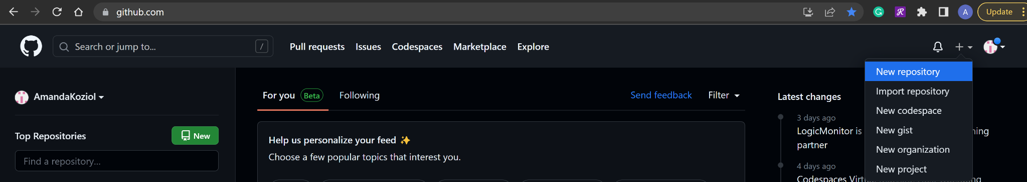
MAKE LOCAL GITHUB REPO
After logging in, go to the GitHub home page at github.com
In the top right corner, click the plus (+) icon
In the dropdown, select “New repository”

Slide 6
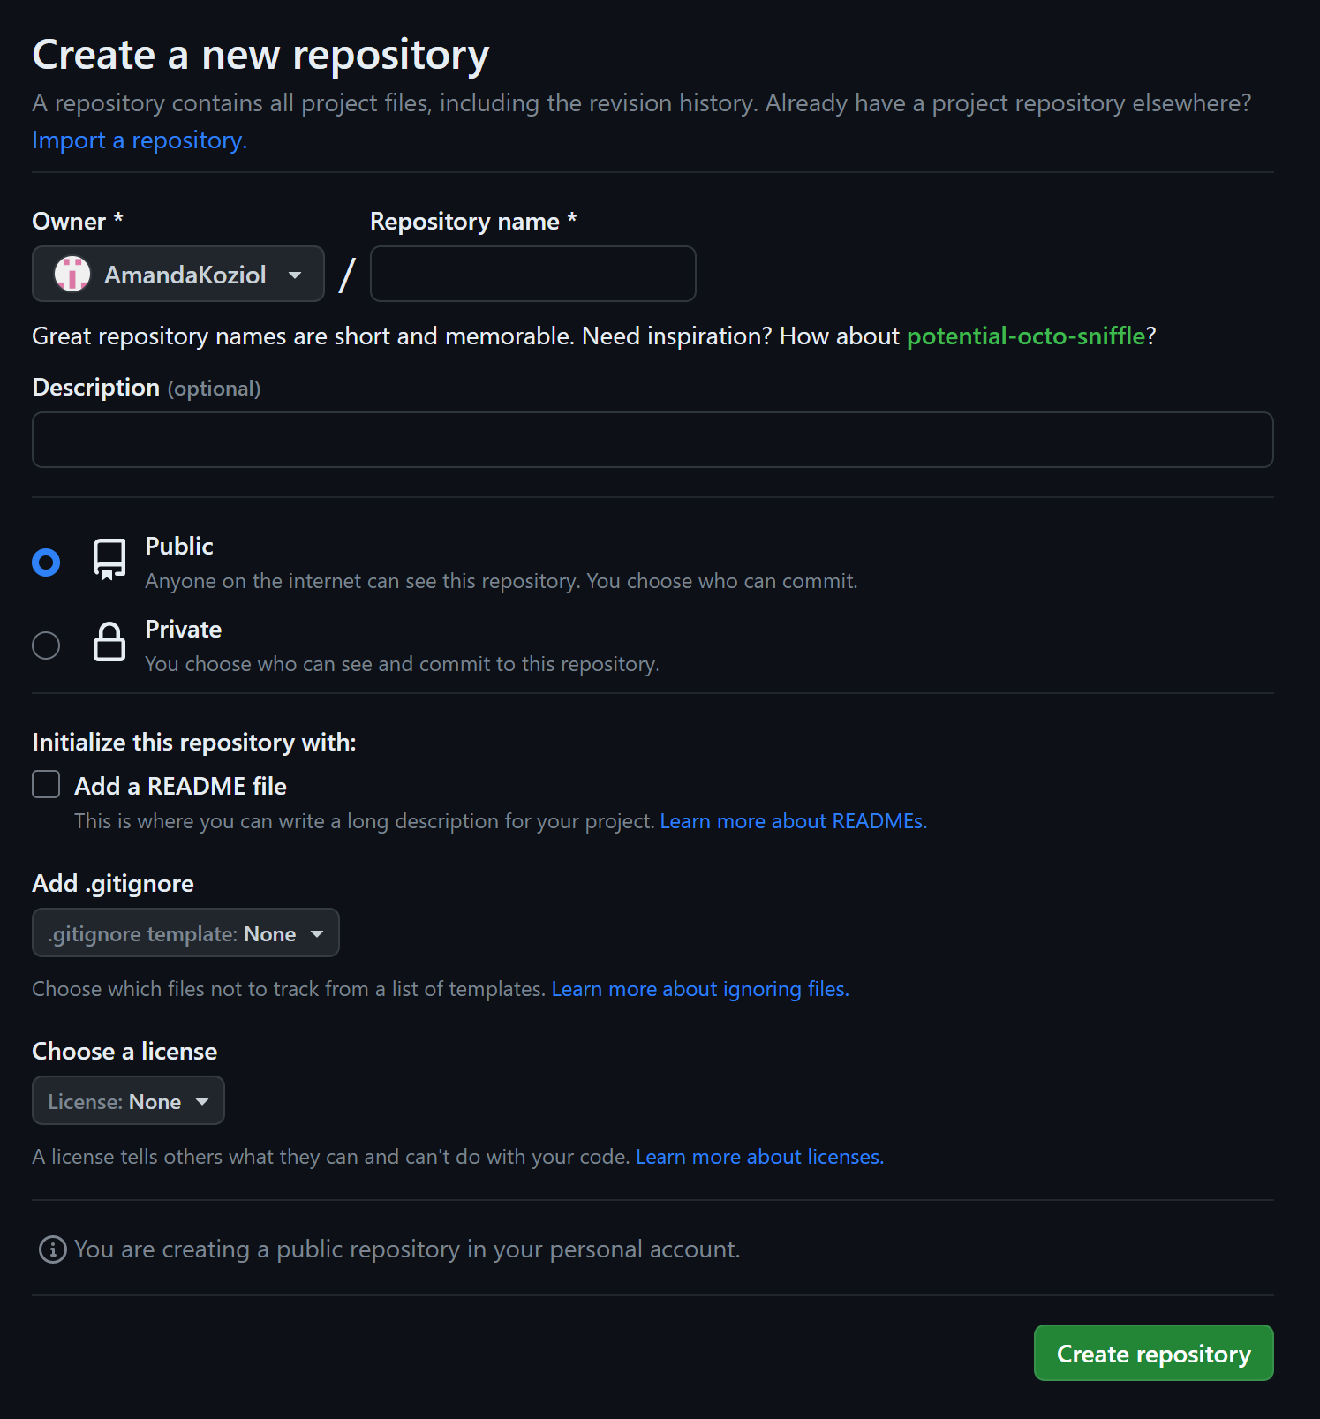
CONFIGURE REPO
In the new page, fill out repository information and click “Create repository”
It is good practice to initialize repositories with a README file so users can document import information like how to use the code
.gitignore is a file that specifies which local files to not include in the repository

Slide 7
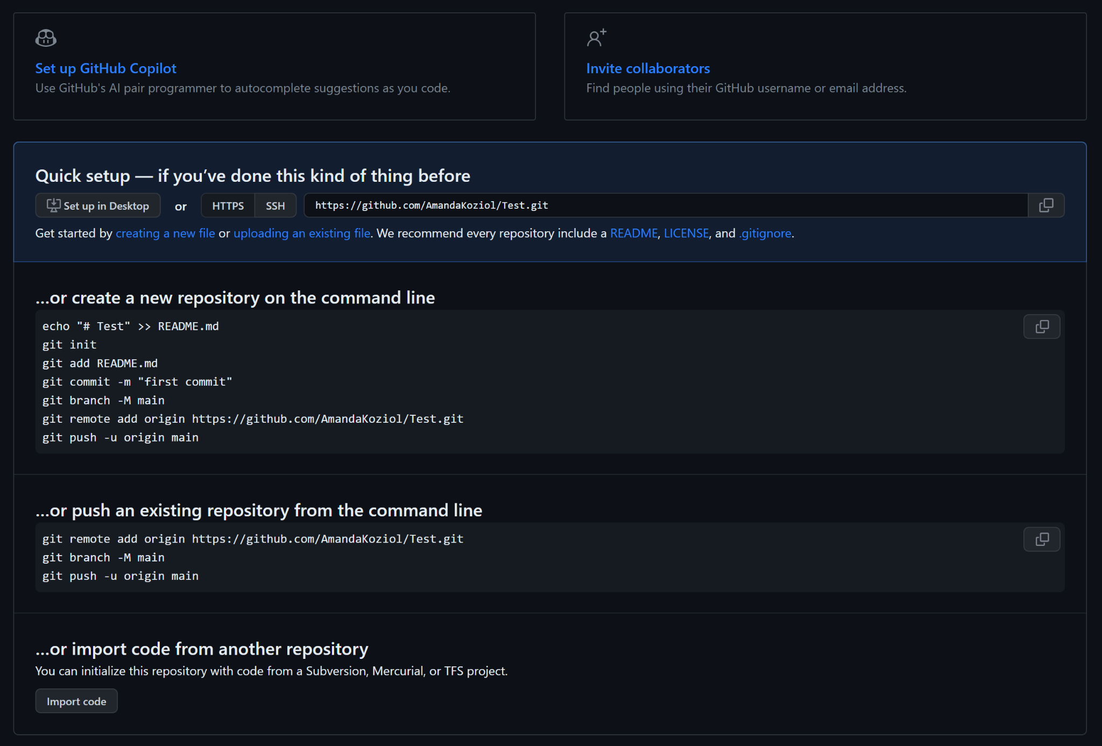
ADD TO REPO
1
In the next page, there are options to
Invite collaborators
Import a local repository
Simply follow directions on the page to do so
2

Slide 8
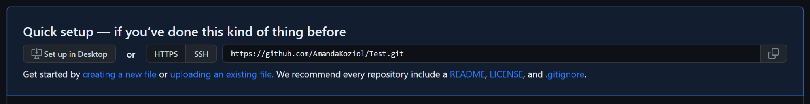
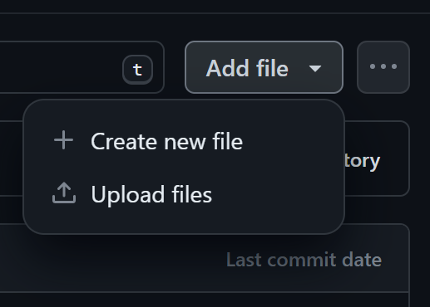
ADD FILE TO REPOSITORY
In the same page, to add the first file to the repository, in the Quick setup box, click “creating a new file” or “uploading an existing file”
Or if there are already files in the repo, click “add file” in the top right

Slide 9
Ice Breakers
CLONE REPO TO LOCAL

Slide 10
WHY CLONE GITHUB REPO
Cloning a GitHub repository allows developers to work on a repository on their local machine with preferred IDE’s and commit any work
If the GitHub repository is downloaded instead of cloned, the developer cannot commit work to the GitHub repository. The downloaded file will also not be a git file or support git commands

Slide 11
CLONE REPO OPTIONS
There are multiple ways to clone a GitHub repository, but only HTTP will be covered in this workshop
Cloning with SSH is also popular, but requires a SSH key to be generated. Cloning with SSH can be found in GitHub documentation here

Slide 12
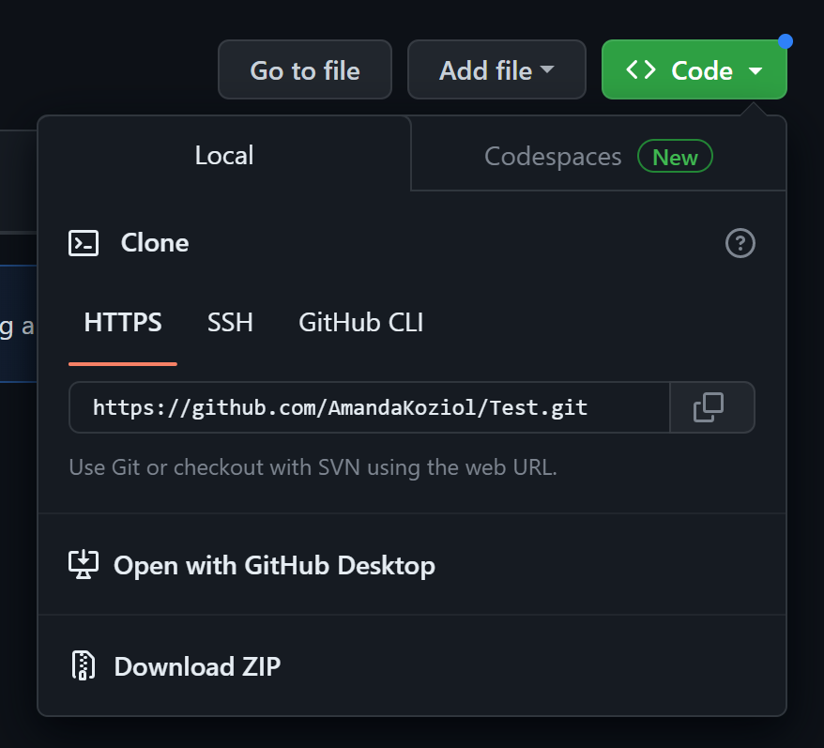
CLONE REPO WITH HTTPS
On the repository main page, select “Code” and “HTTPS”
Copy the link and paste into local git bash or terminal in the following format: git clone copiedLink where copiedLink is the copied HTTPS link
A new folder will appear on the local machine with the same name as the repository to be used in desired IDE

Slide 13
Ice Breakers
MAKE NEW BRANCH

Slide 14
MAKE A NEW BRANCH
In git bash or terminal, navigate (cd) to cloned GitHub repository
Make a branch called myBranch
git branch myBranch
Go to myBranch
git checkout myBranch

Slide 15
COMMIT IN BRANCH
Make changes to myBranch by modifying, adding, or removing files
Add modified, new, or deleted files to the staging environment
git add .
Commit changes to myBranch
git commit -m “myBranch edits”

Slide 16
PUSH BRANCH COMMITS
Upload (push) local commits in myBranch to the GitHub repository so other developers can see them
git push
The first push will require to specify the origin of the branch
git push origin myBranch

Slide 17
PULL BRANCH COMMITS
Update (pull) local clone with commits pushed to the GitHub repository by other developers
git pull

Slide 18
Ice Breakers
CREATE PULL REQUEST

Slide 19
WHAT IS A PULL REQUEST
A pull request (PR) notifies the GitHub repository owners that a member wants to merge code in a branch with the main branch
In response, repository owners will look at the code in the PR branch and will either approve or reject the merge request

Slide 20

CREATE A PULL REQUEST
In the GitHub repository page, navigate to the “Pull requests” tab
Click the “Compare & pull request button”

Slide 21
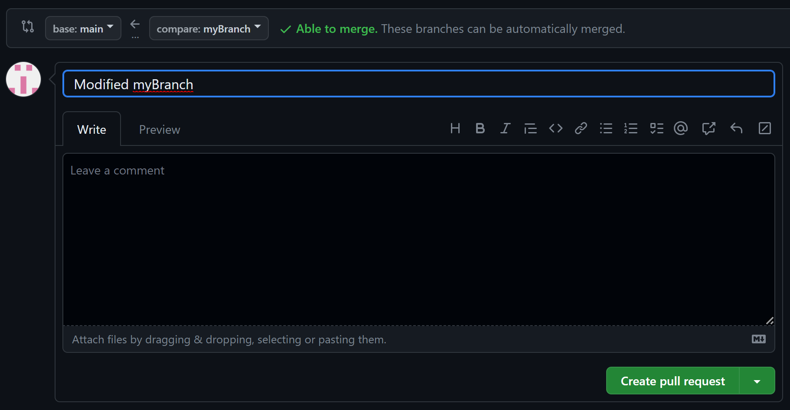
CREATE A PULL REQUEST
In the next page, title the pull request leaving a detailed comment. Then, click “Create pull request”

Slide 22
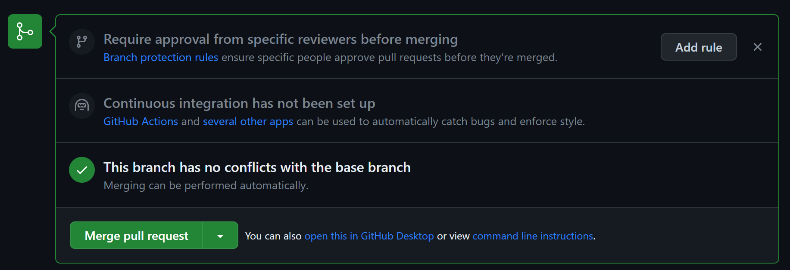
MERGE A PULL REQUEST
In the next page, if the pull request does not require approval or if all required users approved, the green “Merge pull request” box will appear to merge the branches

Slide 23

PULL REQUEST CLEAN UP
Next, GitHub offers the option to delete the old branch
Finally, update your repository clone
git pull

